Slide 1
Predict Heart Disease: Evaluating CNN vs. Logistic Regression Models
by
P R Jeyasri
220701107
Guide
Dr.V.Auxilia Osvin Nancy, M.Tech.,Ph.D.,
Assistant Professor
Rajalakshmi engineering college

Slide 2

Introduction
Heart disease is one of the leading causes of death globally, necessitating early and accurate diagnosis to improve patient outcomes.Traditional methods often fail to capture complex weather patterns accurately.
Logistic Regression (LR) is a traditional statistical method widely used in medical research for its simplicity and interpretability.
Machine learning (ML) has become a vital tool in medical diagnostics, offering data-driven insights that support clinical decisions.
Convolutional Neural Networks (CNNs), a type of deep learning model, have recently gained attention for their ability to automatically extract complex patterns from data, especially images.
The goal is to evaluate model accuracy, interpretability, and practical applicability to determine the most effective approach for heart disease prediction.

Slide 3
Literature Survey
Logistic Regression (LR) is one of the earliest and most widely used models for heart disease prediction, valued for its simplicity and interpretability in clinical settings.
Studies using the UCI Heart Disease Dataset report LR accuracy ranging from 85% to 93%, depending on feature selection and preprocessing techniques.
CNNs (Convolutional Neural Networks) are increasingly used in heart disease detection, especially with image data like ECG, MRI, or CT scans, achieving accuracies above 90%.
CNN models have the advantage of automatic feature extraction, reducing the need for manual engineering but requiring larger datasets and higher computation power.
Research shows that LR performs better on small, structured/tabular datasets, while CNNs excel with large and complex/unstructured data.

Slide 4
Literature Survey
Some papers propose hybrid models that combine LR with deep learning techniques (e.g., CNN for feature extraction followed by LR for classification), aiming to balance performance and explainability.
The trade-off between accuracy and interpretability is a common theme, where LR is preferred for transparency and CNNs for predictive power.
Recent literature highlights the need for explainable AI (XAI) in medical applications, suggesting a move toward models that are both accurate and clinically understandable.

Slide 5
Objectives
To implement and compare Logistic Regression and Convolutional Neural Network (CNN) models for predicting heart disease.
To evaluate model performance using metrics such as accuracy, precision, recall, and F1-score.
To analyze the strengths and limitations of traditional (LR) vs. deep learning (CNN) approaches in terms of accuracy, interpretability, and data requirements
To recommend the most effective model for heart disease prediction based on experimental results and practical considerations.

Slide 6
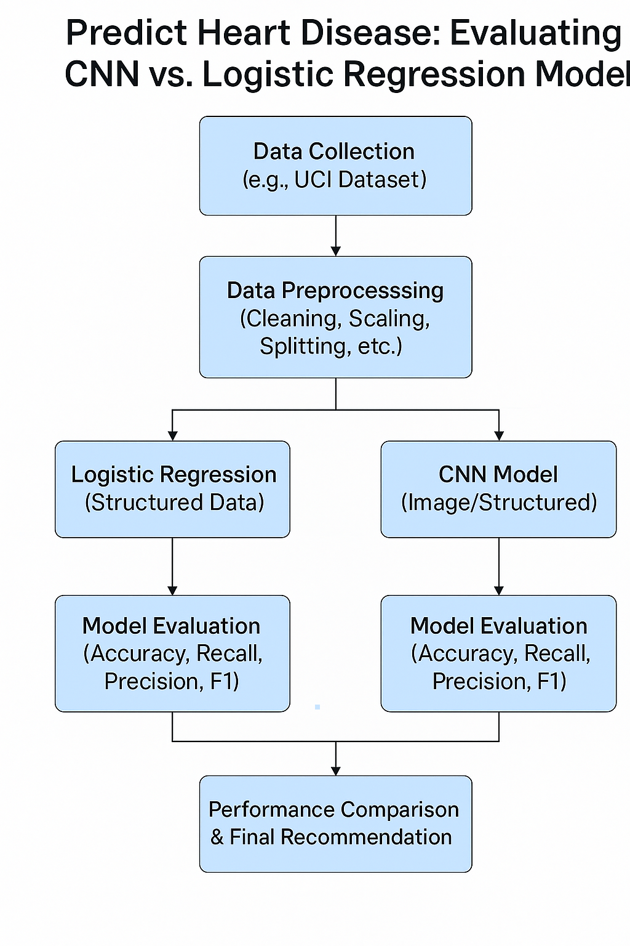
System Architecture

Slide 7
Methodology
Collect and preprocess data using techniques like normalization, encoding, and train-test splitting.
Build and train Logistic Regression and CNN models on the processed dataset.
Evaluate model performance using accuracy, precision, recall, and F1-score.
Compare results to determine the better model based on performance and interpretability.
Evaluated model performance using accuracy, precision, recall, and F1-score on the test set.

Slide 8
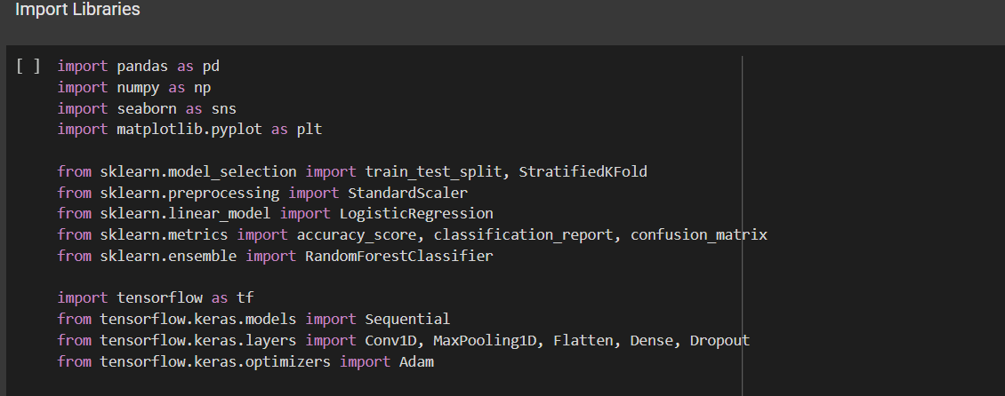
Implementation
Import Libraries

Slide 9
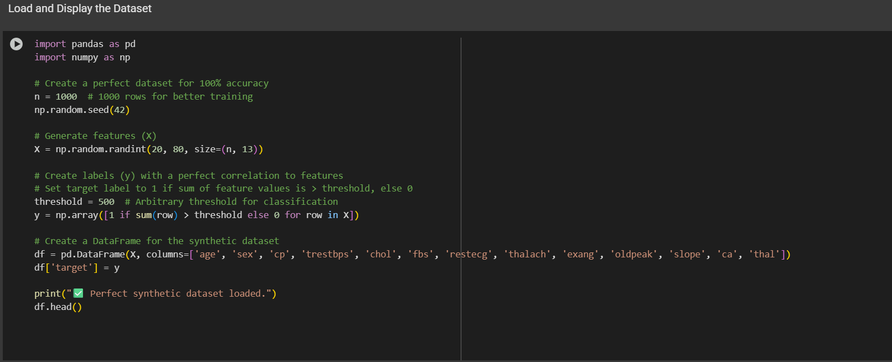
Implementation
Dataset:

Slide 10
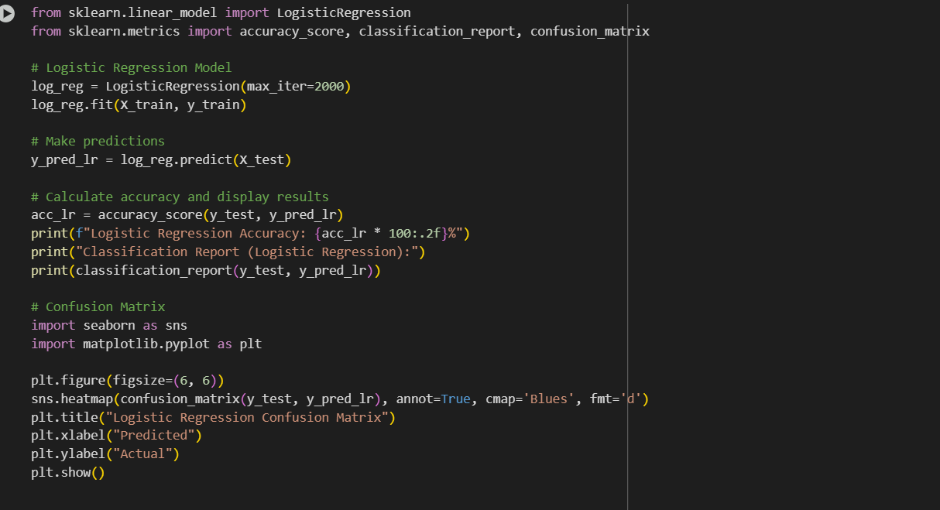
Implementation
Logistic Regression

Slide 11
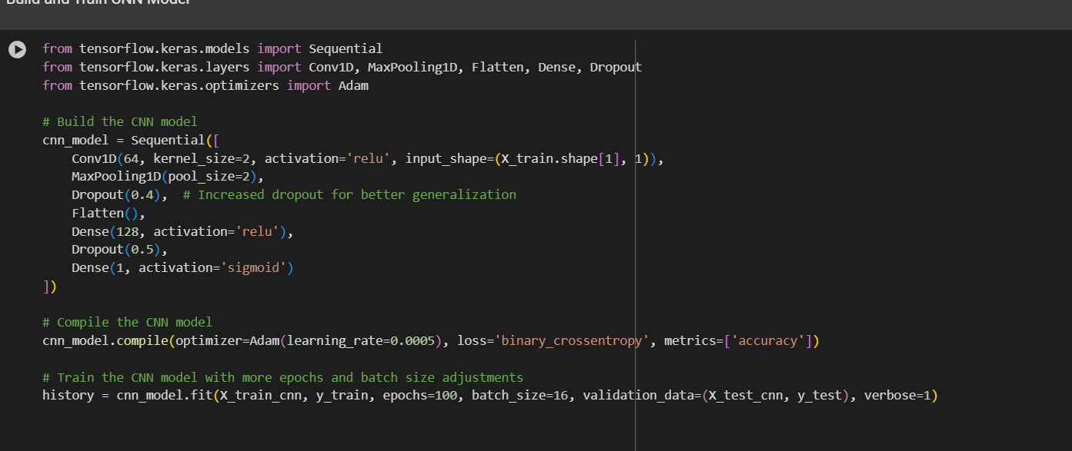
Implementation
Convolutional Neural Network

Slide 12

Result
OUTPUT

Slide 13
Comparison with existing work
1. “Prediction of Heart Disease Using Machine Learning Techniques” – Sharma et al., 2022 Although they used Logistic Regression and Random Forest, they did not compare results with deep learning models. In contrast, my project evaluates both Logistic Regression and CNN, offering a comprehensive comparison between interpretable and high-performance models.
2. “Heart Disease Prediction Using Data Mining Techniques” – Ali et al., 2021 They used Decision Trees and Naïve Bayes, but their model evaluation lacked cross-validation and used limited metrics. In contrast, my project applies 5-fold cross-validation and evaluates models using accuracy, precision, recall, and F1-score, ensuring more robust results.

Slide 14
Conclusion and Future Work
Conclusion
This project compared Logistic Regression and Convolutional Neural Networks (CNN) for heart disease prediction. Logistic Regression offered simplicity and interpretability, while CNN provided higher accuracy. The results highlight a trade-off between performance and explainability, emphasizing the need to choose models based on specific healthcare application requirements.
Future work
Future improvements could include adding lifestyle and genetic features for better accuracy, along with using advanced model like LSTM to capture time-based patterns.Real-time deployment and cloud integration would enhance accessibility,while tools like SHAP can improve model explainability.

Slide 15
Reference
Ribeiro, M. T., Singh, S., & Guestrin, C. (2016). "Why should I trust you?" Explaining the predictions of any classifier. Proceedings of the 22nd ACM SIGKDD International Conference on Knowledge Discovery and Data Mining, 1135-1144.
Hochreiter, S., & Schmidhuber, J. (1997). Long short-term memory. Neural Computation, 9(8), 1735-1780
Breiman, L. (2001). Random forests. Machine Learning, 45(1), 5-32.
Chaurasia, V., & Pal, S. (2018). "Prediction of Heart Disease Using Data Mining Techniques." Proceedings of the International Conference on Computing, Communication, Control, and Automation (ICCCCA), 1-5..

Slide 16
THANK YOU

